Slide 1
ICT - 4231 OBJECT ORIENTED SOFTWARE ENGINEERING
Lecture - 5
Chapter – 8 : Object Design: Reusing Pattern Solutions
Mehrin Anannya
Assistant Professor, IIT, JU

Slide 2
Contents
Introduction
An Overview of Object Design
Reuse Concepts: Solution Objects, Inheritance, and Design Patterns

Slide 3
Introduction
Chapter – 8: Object Design
“
Cheating rule: You cheat if you do not acknowledge the contribution made by others.
”
-----15-413, Software Engineering, Carnegie Mellon University

Slide 4
Introduction
Chapter – 8: Object Design
During system design, the system's purpose is described, leading to the identification of application objects. This phase also involves defining the system's architecture, including subsystem decomposition, global control flow, and persistency management, as well as selecting the hardware/software platform.
Object design follows, aiming to bridge the gap between application objects and off-the-shelf components. This involves identifying additional solution objects, refining existing objects, and incorporating reuse, service specification, model restructuring, and optimization.
Object design, like system design, is not algorithmic but relies on identifying existing patterns and components. The chapter primarily focuses on reuse, with subsequent chapters addressing service specification, model restructuring, and optimization activities.

Slide 5
An Overview of Object Design
Chapter – 8: Object Design
Analysis is the initial phase, wherein the system is described in terms of its external behavior, including functionality (use case model), application domain concepts (object model), behavior in interactions (dynamic model), and nonfunctional requirements.
System design follows, aiming to reduce the gap in two ways. Firstly, it results in a virtual machine that offers a higher level of abstraction than the physical machine, achieved through the selection of off-the-shelf components for standard services and application domain objects. Secondly, system design identifies reusable class libraries and off-the-shelf components.
Object design completes the development process by addressing the remaining pieces of the puzzle. This involves identifying new solution objects, adjusting off-the-shelf components, and precisely specifying subsystem interfaces and classes. The object design model is then partitioned into sets of classes for implementation by individual developers.

Slide 6
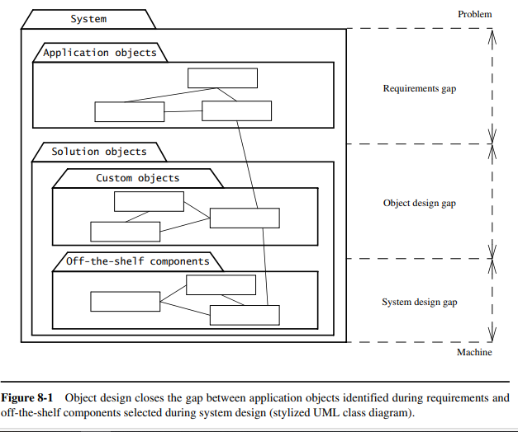
An Overview of Analysis
Chapter – 8: Object Design

Slide 7
An Overview of Analysis
Chapter – 8: Object Design
Object design includes four groups of activities:
Reuse: During system design, off-the-shelf components, class libraries, and design patterns are utilized to implement subsystems, providing basic data structures, services, and solutions for common problems. These components and patterns may require adaptation, achieved through custom object wrapping or refinement via inheritance. Developers must navigate buy-versus-build trade-offs, considering factors such as cost and project requirements throughout these activities.
Interface specification: During service specification, subsystem interfaces are defined with operations, arguments, types, and exceptions. Additional elements for data transfer between subsystems are also identified. This results in a subsystem API, outlining the interface for each subsystem.
Restructuring: Restructuring activities in software development involve manipulating the system model to enhance code reuse and achieve design objectives. These activities often entail graph transformations on subsets of the model, such as converting N-ary associations to binary associations or merging similar classes into a single class. Other common actions include collapsing classes with minimal behavior into attributes, splitting complex classes into simpler ones, and rearranging classes and operations to optimize inheritance and packaging. Ultimately, restructuring aims to improve the maintainability, readability, and understandability of the system model.

Slide 8
An Overview of Analysis
Chapter – 8: Object Design
Optimization: Optimization activities aim to meet performance requirements by adjusting algorithms for speed or memory, minimizing multiplicities in associations, introducing redundant associations for efficiency, optimizing execution orders, incorporating derived attributes for faster access to objects, and enhancing architecture by providing access to lower layers for improved performance.

Slide 9
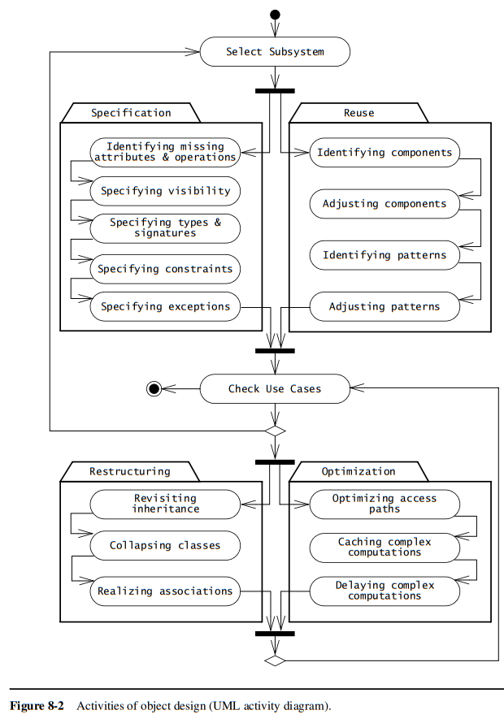
An Overview of Analysis
Chapter – 8: Object Design

Slide 10
Reuse Concepts: Solution Objects, Inheritance, and Design Patterns
Chapter – 8: Object Design
In this section, we present the object design concepts related to reuse:
• Application Objects and Solution Objects
• Specification Inheritance and Implementation Inheritance
• Delegation
• The Liskov Substitution Principle
• Delegation and Inheritance in Design Patterns

Slide 11
Application Objects and Solution Objects
Chapter – 8: Object Design
Class diagrams model both application and solution domains. Application objects, or domain objects, represent domain concepts relevant to the system. Solution objects represent components unique to the system, like data stores or user interface elements.
During analysis, entity objects and their attributes, relationships, and operations are identified. Most entity objects are independent application objects. Additionally, visible solution objects like boundary and control objects are identified.
In system design, more solution objects related to software and hardware platforms are identified. Object design refines both application and solution objects and fills design gaps with additional solution objects.

Slide 12
Specification Inheritance and Implementation Inheritance
Chapter – 8: Object Design
In the analysis phase, inheritance serves to classify objects into taxonomies, distinguishing common behaviors in superclass (or base class) from specific behaviors in subclasses (or derived classes). This hierarchical organization aids in understanding the system's functionality, allowing readers to navigate from abstract concepts to concrete ones. For instance, in the FRIEND emergency response system analysis model, understanding general incident handling precedes examining specific cases like traffic accidents or fires, facilitating comprehension of specialized behaviors.
During object design, inheritance aims to minimize redundancy and facilitate extensibility. By consolidating shared behavior in a superclass, risks of inconsistencies during changes are reduced, and abstract classes/interfaces guide the creation of new specialized subclasses. For example, an abstract Image class with various format-specific subclasses simplifies extending image manipulation applications. However, misuse of inheritance can lead to opaque and fragile code, particularly when inheritance hierarchies introduce unwanted coupling between unrelated concepts, as demonstrated by subclassing Hashtable to implement a set abstraction.

Slide 13
Specification Inheritance and Implementation Inheritance
Chapter – 8: Object Design
The distinction between implementation inheritance (for code reuse) and specification inheritance (for concept classification) is crucial. While implementation inheritance allows quick code reuse by refining existing behavior, it may create tight coupling and hinder flexibility. In contrast, specification inheritance focuses on classifying concepts into type hierarchies, facilitating understanding and maintainability. Awareness of these nuances is essential to leverage inheritance effectively and mitigate its potential drawbacks in software design.

Slide 14
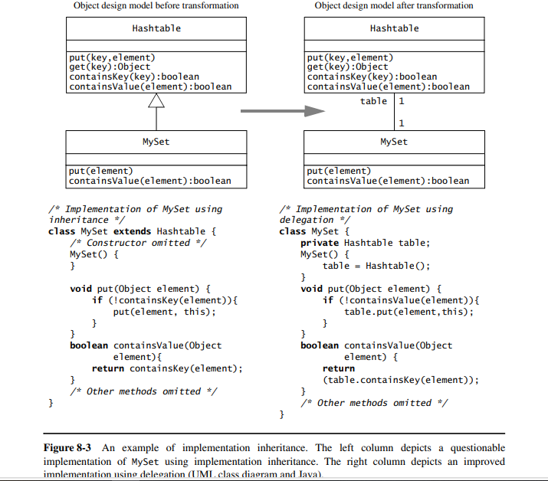
Specification Inheritance and Implementation Inheritance
Chapter – 8: Object Design

Slide 15
Specification Inheritance and Implementation Inheritance
Chapter – 8: Object Design
The use of inheritance for the sole purpose of reusing code is called implementation inheritance. With implementation inheritance, developers reuse code quickly by subclassing an existing class and refining its behavior. A Set implemented by inheriting from a Hashtable is an example of implementation inheritance. Conversely, the classification of concepts into type hierarchies is called specification inheritance (also called “interface inheritance”). The UML class model of Figure 8-4 summarizes the four different types of inheritance we discussed in this section.

Slide 16
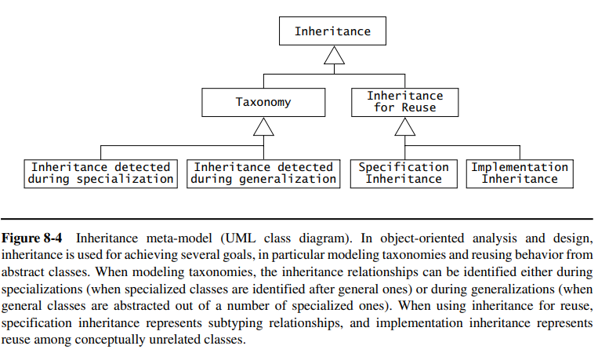
Specification Inheritance and Implementation Inheritance
Chapter – 8: Object Design

Slide 17
Delegation
Chapter – 8: Object Design
Delegation is the alternative to implementation inheritance that should be used when reuse is desired. A class is said to delegate to another class if it implements an operation by resending a message to another class. Delegation makes explicit the dependencies between the reused class and the new class. The right column of Figure 8-3 shows an implementation of MySet using delegation instead of implementation inheritance. The only significant change is the private field table and its initialization in the MySet() constructor. This addresses both problems we mentioned before:
Extensibility: The MySet on the right column does not include the containsKey() method in its interface and the new field table is private. Hence, we can change the internal representation of MySet to another class (e.g., a List) without impacting any clients of MySet.
Subtyping: MySet does not inherit from Hashtable and, hence, cannot be substituted for a Hashtable in any of the client code. Consequently, any code previously using Hashtables still behaves the same way.
Delegation is a preferable mechanism to implementation inheritance as it does not interfere with existing components and leads to more robust code. Note that specification inheritance is preferable to delegation in subtyping situations as it leads to a more extensible design.

Slide 18
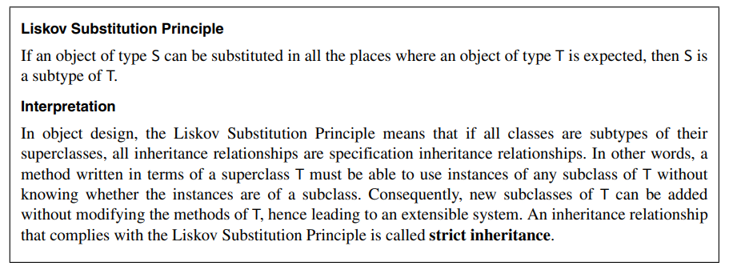
The Liskov Substitution Principle
Chapter – 8: Object Design
The Liskov Substitution Principle [Liskov, 1988] provides a formal definition for specification inheritance. It essentially states that, if a client code uses the methods provided by a superclass, then developers should be able to add new subclasses without having to change the client code. For example, in the left column of Figure 8-3, this means that, if a client uses a Hashtable, the client should not have to be modified when we substitute the Hashtable for any of its subclasses, for example MySet. Clearly, this is not the case, so the relationship between MySet and Hashtable is not a specification inheritance relationship. Below is the formal definition of the Liskov Substitution Principle:

Slide 19
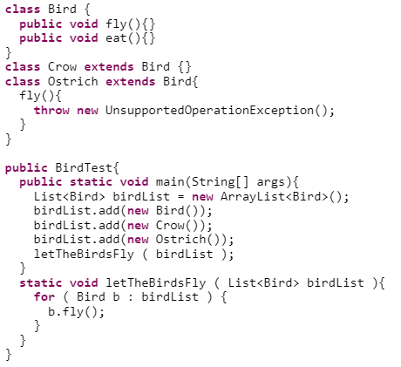
The Liskov Substitution Principle(cont.)

Slide 20
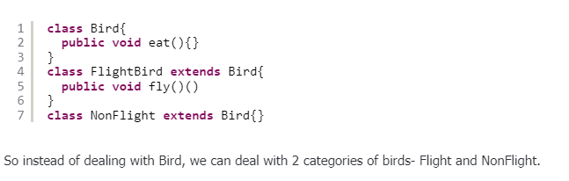
The Liskov Substitution Principle(cont.)

Slide 21
Delegation and Inheritance in Design Patterns
Chapter – 8: Object Design
Inheritance and delegation, used in different combinations, can solve a wide range of problems: decoupling abstract interfaces from their implementation, wrapping around legacy code, and/or decoupling classes that specify a policy from classes that provide mechanism.
In object-oriented development, design patterns are template solutions that developers have refined over time to solve a range of recurring problems [Gamma et al., 1994]. A design pattern has four elements:
A name that uniquely identifies the pattern from other patterns.
A problem description that describes the situations in which the pattern can be used. Problems addressed by design patterns are usually the realization of modifiability and extensibility design goals and nonfunctional requirements.
A solution stated as a set of collaborating classes and interfaces.
A set of consequences that describes the trade-offs and alternatives to be considered with respect to the design goals being addressed.

Slide 22
Delegation and Inheritance in Design Patterns
Chapter – 8: Object Design
Note that the Adapter pattern uses both inheritance and delegation. When studying design patterns, you will notice that many patterns use a mix of inheritance and delegation and therefore look similar. However, the same mechanisms are used in subtly different ways. To clarify the differences, we use the following terms to denote different classes participating in the pattern:
The client class accesses the pattern. In the class diagram of the Adapter pattern (Figure 8-5), this class is simply called Client. Client classes can be either existing classes of a class library or new classes of the system under development.
The pattern interface is the part of the pattern that is visible to the client class. Often, the pattern interface is realized by an abstract class or an interface. In the Adapter pattern, this class is called ClientInterface.
The implementor class provides the lower-level behavior of the pattern. In the Adapter pattern, the LegacyClass and the Adapter are implementor classes. In many patterns, a number of collaborating implementor classes are needed to realize the pattern behavior.
The extender class specializes an implementor class to provide a different implementation or an extended behavior of the pattern. In the Adapter pattern, the subtypes of LegacyClass are extender classes. Note that, often, extender classes represent future classes that developers anticipate

Slide 23
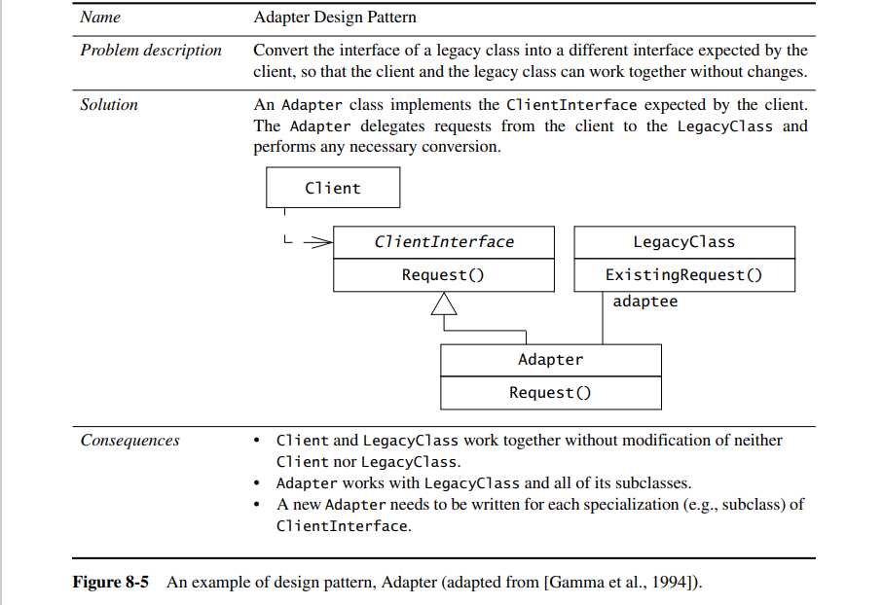
Delegation and Inheritance in Design Patterns
Chapter – 8: Object Design

Slide 24
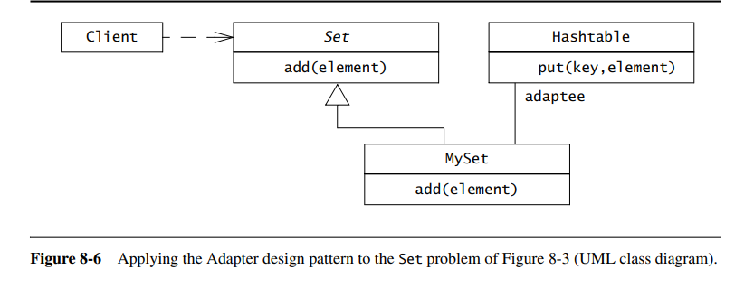
Delegation and Inheritance in Design Patterns(cont.)
Chapter – 8: Object Design

